Slide 1

FINAL PROJECT SUBMISSION
Cyber Threat Analytics platform with incident Visualization System
Milestones 1–4 · Data Integration → Temporal Analytics → Geospatial Intelligence → Executive Risk Analytics
Presented by: Team A — Neeraj Sharma, Abhishek, Vaishnavi, Swetha, Akanksha, Ritika V
Under the supervision of Mr. Sughandar

Slide 2
EXECUTIVE SUMMARY
From Disconnected Data to Risk Intelligence
Four milestones, one continuous pipeline — turning 5 siloed source systems into a forecasting-capable security dashboard.
6,000
5
1 + 5
58.70
0.10%
72.22
Incidents Modeled
Raw Sources Integrated
Fact + Dimension Tables
Avg Threat Severity Index
Anomaly Rate (Z-Score)
Forecast TSI
The problem: Threat data arrived from 5 disconnected systems, each with its own format, key structure, and quality profile — making it impossible to get one reliable view of security activity.
The solution: A validated star-schema data model, layered with temporal trend analysis, statistical anomaly detection, geospatial hotspot mapping, and an 8-week predictive risk forecast — delivered as a live, filterable Power BI dashboard suite.
THREAT INTEL FRAMEWORK · FINAL SUBMISSION
02

Slide 3




PROJECT ROADMAP
The 4-Milestone Journey
Each milestone builds directly on the data model and insights from the one before it.
Milestone 1
Milestone 2
Milestone 3
Milestone 4
Data Integration &
Incident Modeling
→
Threat Intelligence &
Temporal Analytics
→
Geospatial Intelligence &
Response Analytics
→
Risk Intelligence &
Executive Analytics
Weeks 1–2
Weeks 3–4
Weeks 5–6
Weeks 7–8
Decision chain: Incidents → Trends & Anomalies → Location & Risk → Forecast & Executive Action
THREAT INTEL FRAMEWORK · FINAL SUBMISSION
03

Slide 4
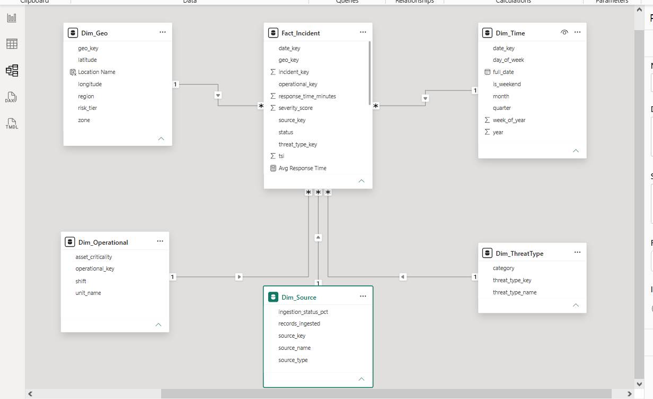
MILESTONE 1 · WEEKS 1–2
Data Integration & Incident Modeling
5 disconnected raw sources → 1 validated star schema, cleaned and standardized from scratch.
WHAT WAS BUILT
5 raw sources integrated: Incident Logs, Operational Data, Environmental Feeds, External Threat Feeds, Geo Metadata.
21 inconsistent category labels standardized into 5 clean threat types.
3 mixed date formats parsed into 1 consistent datetime field.
Star schema built: 1 Fact_Incident table + 5 dimension tables, all relationships validated.
Cleaning pipeline built and run end-to-end in a custom Jupyter notebook — 0 missing values, 0 duplicates confirmed in the final output.
THREAT INTEL FRAMEWORK · FINAL SUBMISSION
04

Slide 5
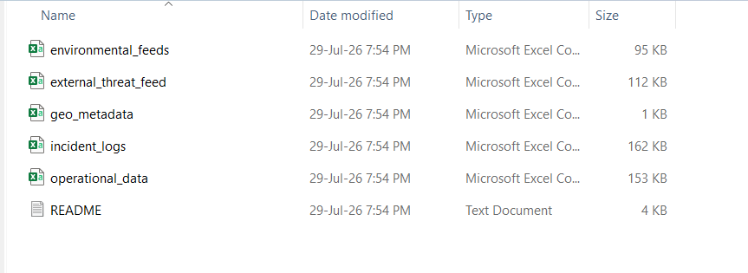
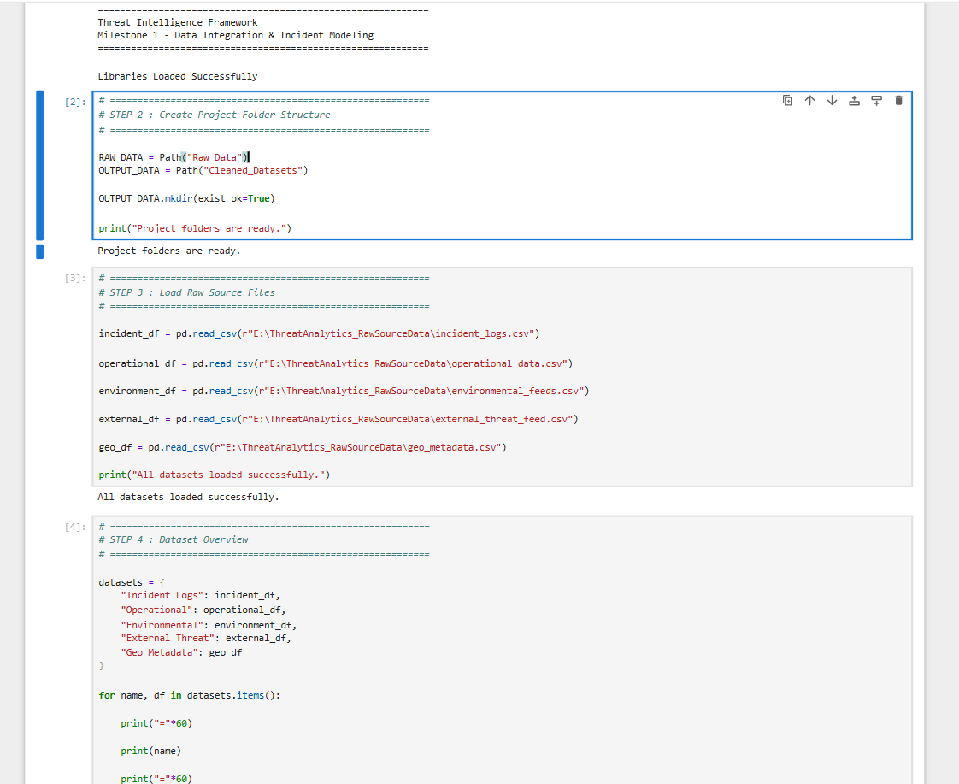
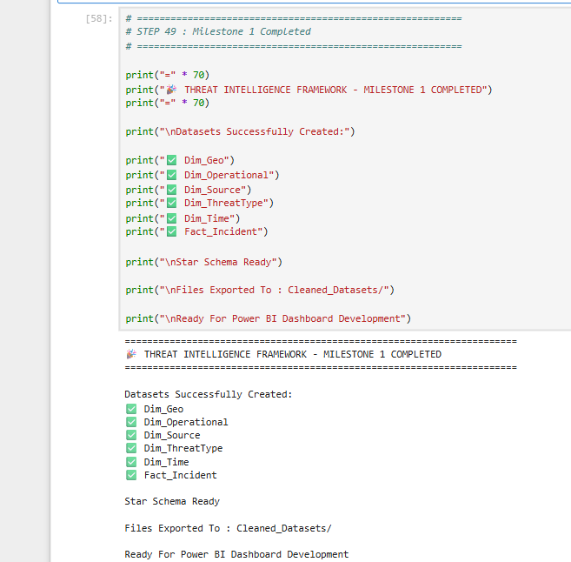
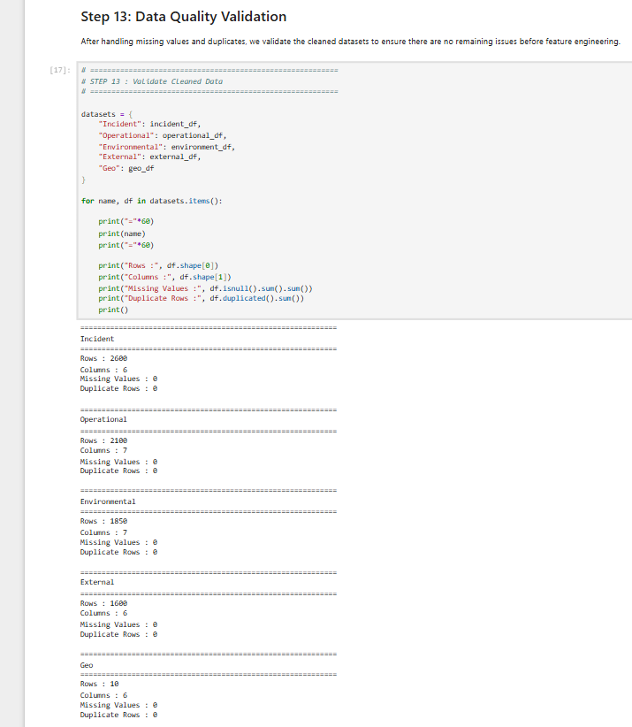
MILESTONE 1 EVIDENCE
The Cleaning Process — Shown, Not Just Claimed
Real raw data, a real notebook, real validation output — built and run independently by the team.
The 5 raw source files, exactly as received — before any cleaning.
THREAT INTEL FRAMEWORK · FINAL SUBMISSION
05

Slide 6
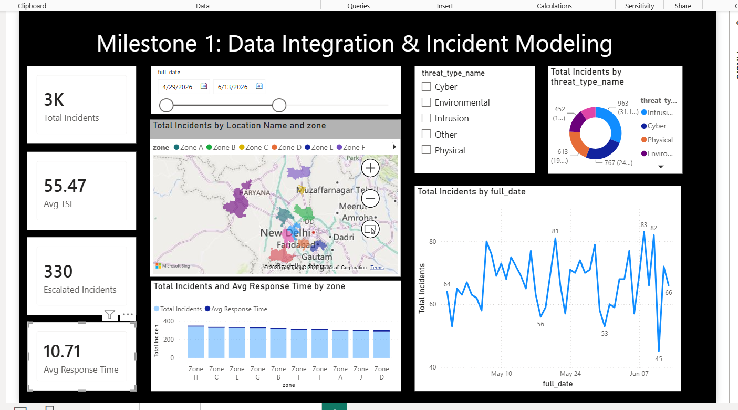
MILESTONE 1 · LIVE OUTPUT
Data Integration Dashboard
The validated star schema, live in Power BI.
THREAT INTEL FRAMEWORK · FINAL SUBMISSION
06

Slide 7
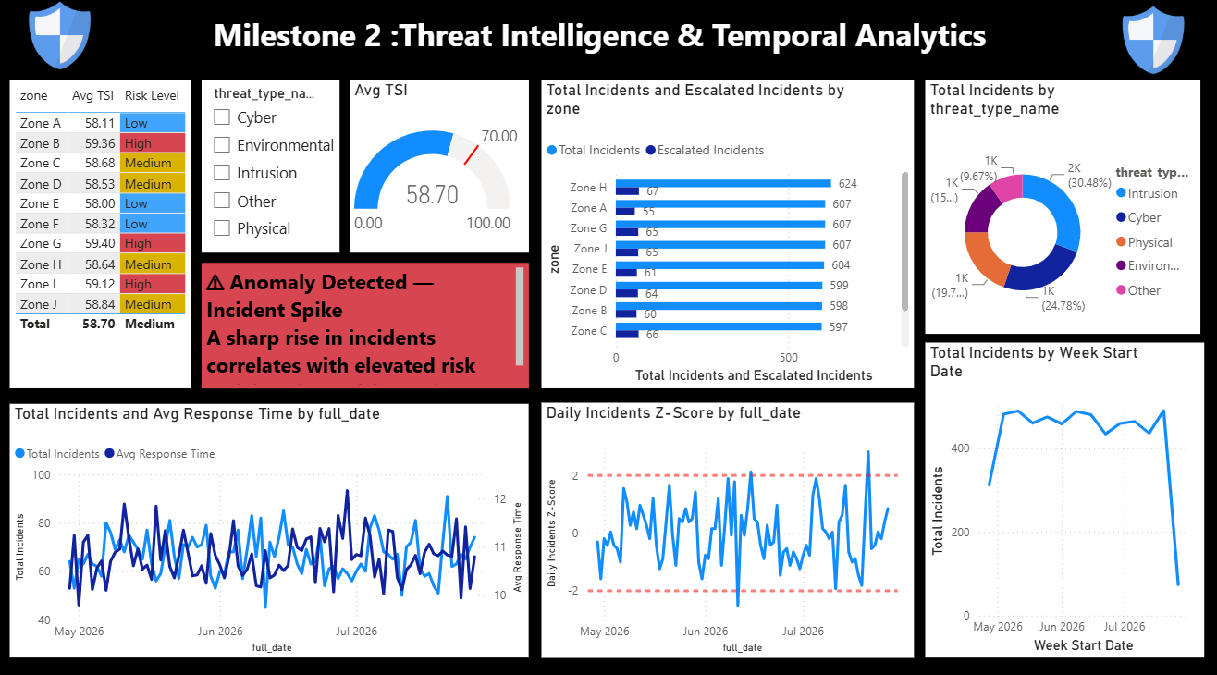
MILESTONE 2 · WEEKS 3–4
Threat Intelligence & Temporal Analytics
Daily, weekly, and monthly trend views, plus statistical anomaly detection using Z-scores.
KEY RESULTS
Avg TSI
58.70 (Medium risk)
Anomaly threshold
|Z-score| ≥ 2
Anomaly rate
0.10% (3 flagged events)
Time windows built
Daily · Weekly · Monthly
Risk levels
Calibrated per-zone bands
Z = (x − μ) / σ — how far each day's incident count sits from the average, in standard deviations.
THREAT INTEL FRAMEWORK · FINAL SUBMISSION
07

Slide 8
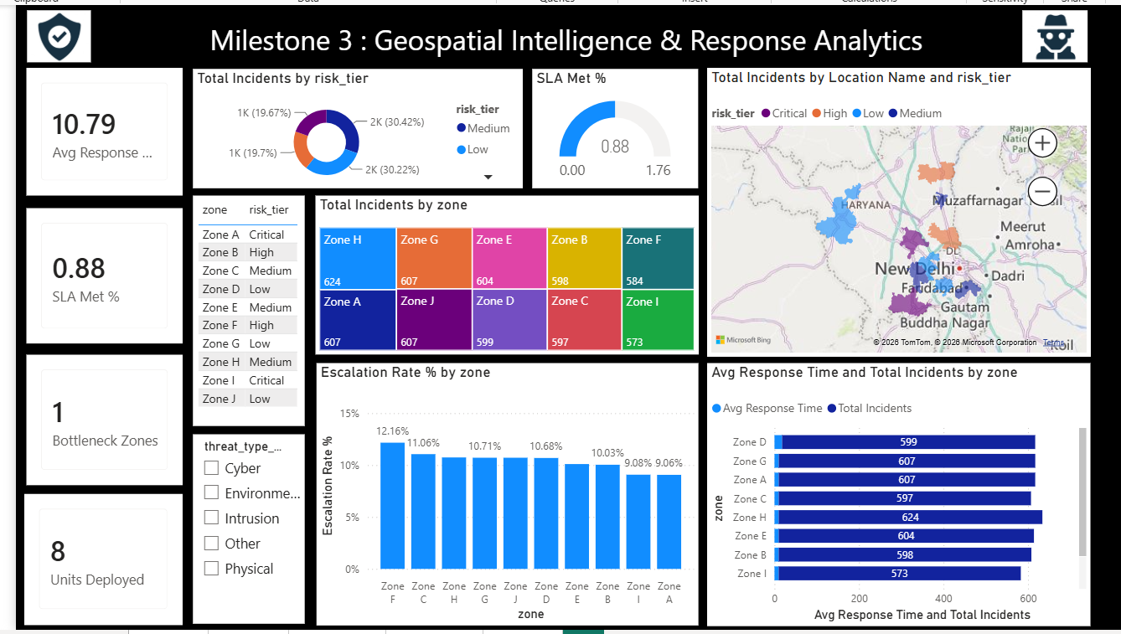
MILESTONE 3 · WEEKS 5–6
Geospatial Intelligence & Response Analytics
From threat location to risk-aware resource deployment — where, how risky, how we respond, and are resources efficient.
KEY RESULTS
Avg response time
10.79 minutes
SLA met
88%
Bottleneck zones
1 zone flagged
Highest incident zone
Zone H — 624 incidents
Units deployed
8 units, by risk tier
Principle: incident count answers "how much" — risk tier answers "how serious." Both are needed to prioritize.
THREAT INTEL FRAMEWORK · FINAL SUBMISSION
08

Slide 9
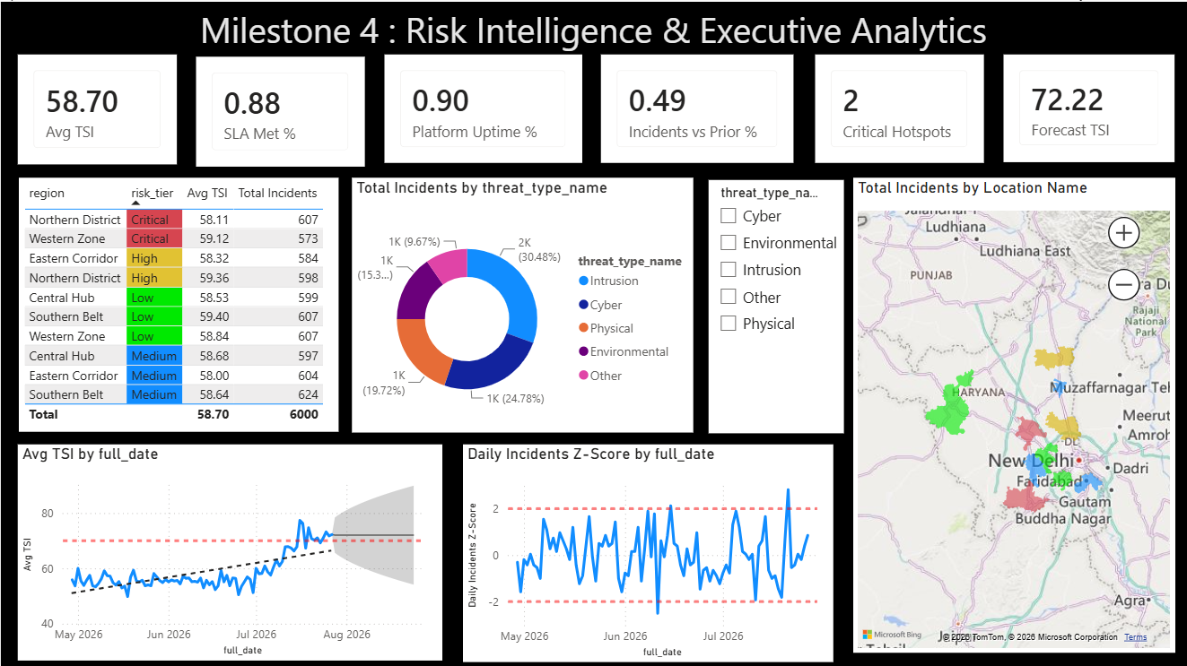
MILESTONE 4 · WEEKS 7–8
Risk Intelligence & Executive Analytics
Historical incidents become a forward-looking executive risk view — assess, predict, decide.
EXECUTIVE KPIs
Avg TSI (current)
58.70
Forecast TSI
72.22 — rising trend
SLA Met / Platform Uptime
88% / 90%
Critical hotspots
2 locations flagged
Forecast method
Power BI built-in forecasting
Forecasts are estimates, not guarantees — a widening confidence band signals more uncertainty, not automatic escalation.
THREAT INTEL FRAMEWORK · FINAL SUBMISSION
09

Slide 10
METHODOLOGY
Visualization Techniques Used Across the Project
Every chart type was chosen for a specific analytical purpose.
Visualization | Data Shown | Purpose
Card / KPI | Single-value metrics (TSI, SLA, response time) | At-a-glance status
Line chart | Daily / weekly / monthly incident & TSI trends | Show temporal patterns
Z-score line chart | Daily incident Z-scores with ±2 limits | Statistical anomaly detection
Clustered bar chart | Incidents & escalations by zone | Compare categories
Donut chart | Incident share by threat type / risk tier | Show composition
Gauge | Avg TSI against a risk threshold | Quick risk read
Map (geospatial) | Zone-level incident & risk-tier hotspots | Location-based prioritization
Table (conditional formatting) | Risk Level & Security Scorecard by zone/region | Ranked, color-coded detail
Forecast chart (with confidence band) | Weekly TSI, 8-period forecast | Predictive risk estimation
THREAT INTEL FRAMEWORK · FINAL SUBMISSION
10

Slide 11


FINDINGS
Key Insights Across All 4 Milestones
Evidence → interpretation, consolidated from the full project.
Data Quality
Trend
Anomalies
5 sources at 82.8%–100% ingestion completeness; every gap was measured and flagged, not hidden.
Weekly and monthly smoothing distinguishes short-lived spikes from sustained risk trends.
Z-score analysis flags statistically real outliers — 0.10% anomaly rate, a screening signal, not proof of attack.
Concentration
Response
Forecast
Zone H consistently shows the highest incident volume (624); incident count and risk tier together drive prioritization.
Avg response time of 10.79 min with 88% SLA compliance — 1 zone flagged as a genuine bottleneck.
Forecast TSI (72.22) trending above current average (58.70) — an early signal for capacity planning.
THREAT INTEL FRAMEWORK · FINAL SUBMISSION
11

Slide 12
DECISION SUPPORT
Executive Decision Framework
How a security manager should act on what the dashboard shows.
High risk + critical hotspot
Immediate investigation, enhanced monitoring, priority resource allocation.
Risk increasing + forecast increasing
Prepare additional response capacity; increase monitoring frequency.
SLA below target
Review response bottlenecks, team workload, and escalation handling.
High incident count but low risk
Optimize workload; do not equate volume alone with criticality.
Principle: measure → locate → predict → prioritize → act → monitor.
THREAT INTEL FRAMEWORK · FINAL SUBMISSION
12

Slide 13

REFLECTION
Challenges & Learnings
An honest look at what was hard, and what it taught the team.
Messy, inconsistent raw data
21 different labels for 5 categories, 3 mixed date formats — solved with explicit standardization logic, not shortcuts.
Two systems, no shared key
Incident logs and operational/response data had no direct foreign key — resolved with a realistic zone + date join.
Geospatial map wouldn't auto-zoom
Power BI's Map visual needed named locations instead of raw coordinates — fixed by reverse-mapping zones to real cities.
Choosing meaningful risk thresholds
Generic Critical/High/Medium/Low bands flattened to one value — recalibrated thresholds to the dataset's real distribution.
Forecasting is an estimate, not a fact
Learned to present confidence bands honestly, and to explain uncertainty rather than hide it.
THREAT INTEL FRAMEWORK · FINAL SUBMISSION
13

Slide 14
CONCLUSION
From Raw Data to Actionable Security Intelligence
What the project delivered, and where it could go next.
WHAT WAS DELIVERED
FUTURE SCOPE
A validated star-schema data model from 5 raw sources
Daily / weekly / monthly temporal analysis
Statistical anomaly detection via Z-score
Geospatial hotspot mapping and response analytics
An 8-week predictive risk forecast
A 4-page executive-ready Power BI dashboard suite
Validate forecast settings and surface the complete 8-week weekly forecast series
Automate scheduled data refresh from live source systems
Extend anomaly detection to threat-type and zone-level Z-scores, not just daily totals
Add role-based dashboard views (analyst vs. executive)
Integrate real SLA/timestamp definitions validated against source systems
THREAT INTEL FRAMEWORK · FINAL SUBMISSION
14

Slide 15
Thank You
Threat Intel Framework — Milestones 1 to 4, Complete
Team A — Neeraj Sharma, Abhishek, Vaishnavi, Swetha, Akanksha, Ritika V
Under the supervision of Mr. Sughandar
THREAT INTEL FRAMEWORK · FINAL SUBMISSION
15

